Slide 1
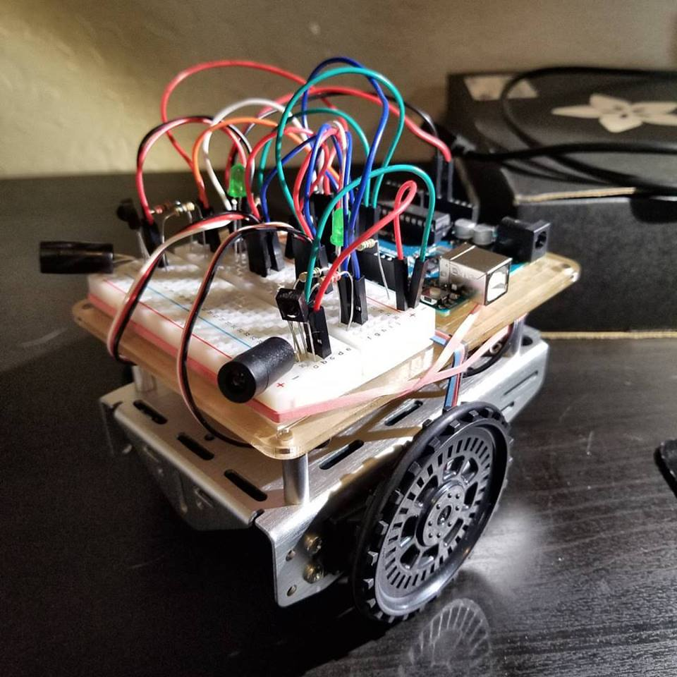
Roaming Arduino-Bot
Using IR LED’s and IR Sensors

Slide 2
What It Does
Pulses IR LEDs at specific frequency
Detects reflected IR light with sensors
Drives servos forward or backward depending on sensor input logic
Effectively roams and avoids obstacles

Slide 3
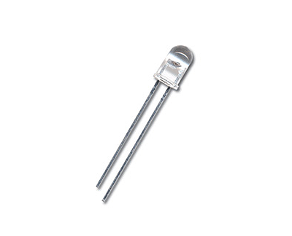
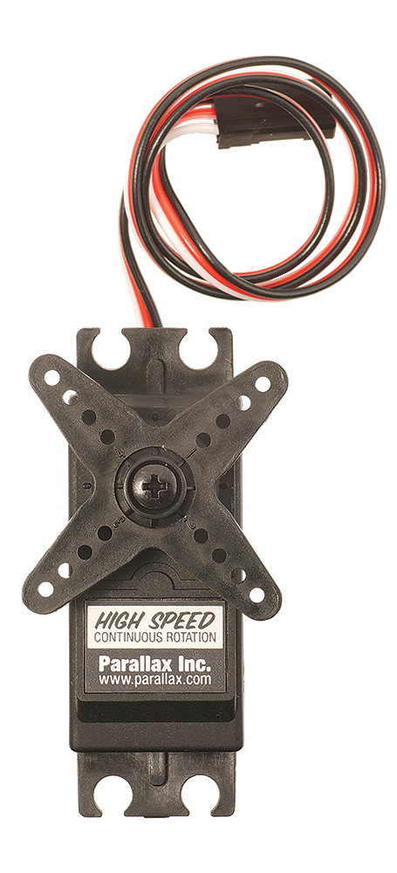
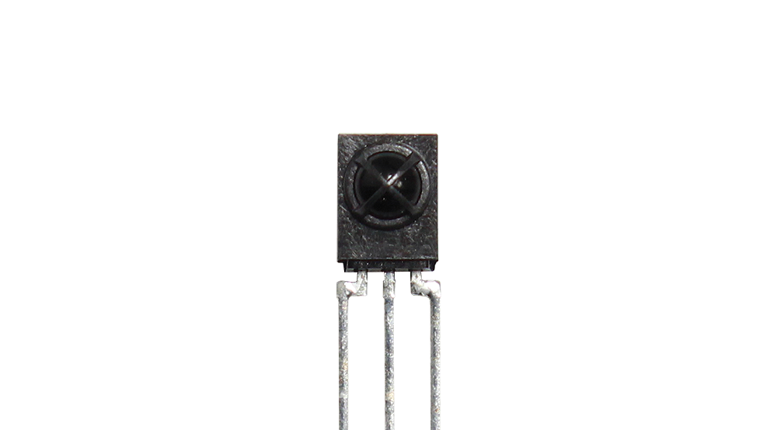
Key Components
2 Continuous Rotation Servos
2 IR LEDs
2 IR Sensors

Slide 4
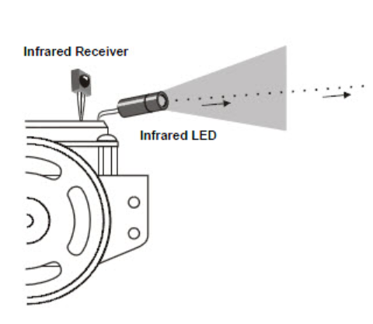
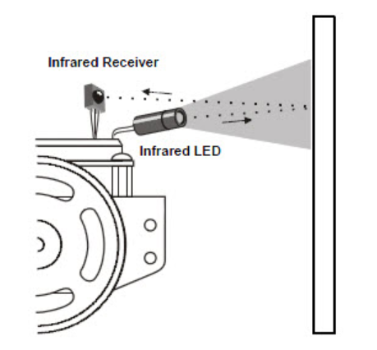
LED and Sensor Function
No obstacle detected
Obstacle detected

Slide 5

Code
The tone() function generates a square wave of the specified frequency on a pin.
The IR sensor input signal is read and stored in a bool.
This logic value passed to the indicator LED.
The noTone() function stops the square wave generation so that tone() can be used on the other LED pin.

Slide 6


Code
No obstacle detected:
Move both servos forward.
Right sensor detects object:
Turn left.
Left sensor detects object:
Turn right.
Both sensors detect object:
Move both servos backward.

Slide 7
Troubleshooting
Servos drain battery FAST.
Delay() 2 ms after moving servos when obstacle encountered
Ambient light can trigger IR sensors. Dim room works best.

